Slide 1
Spring Boot
Chapter 1
(Explains the Project Starter’s Backend)

Slide 2
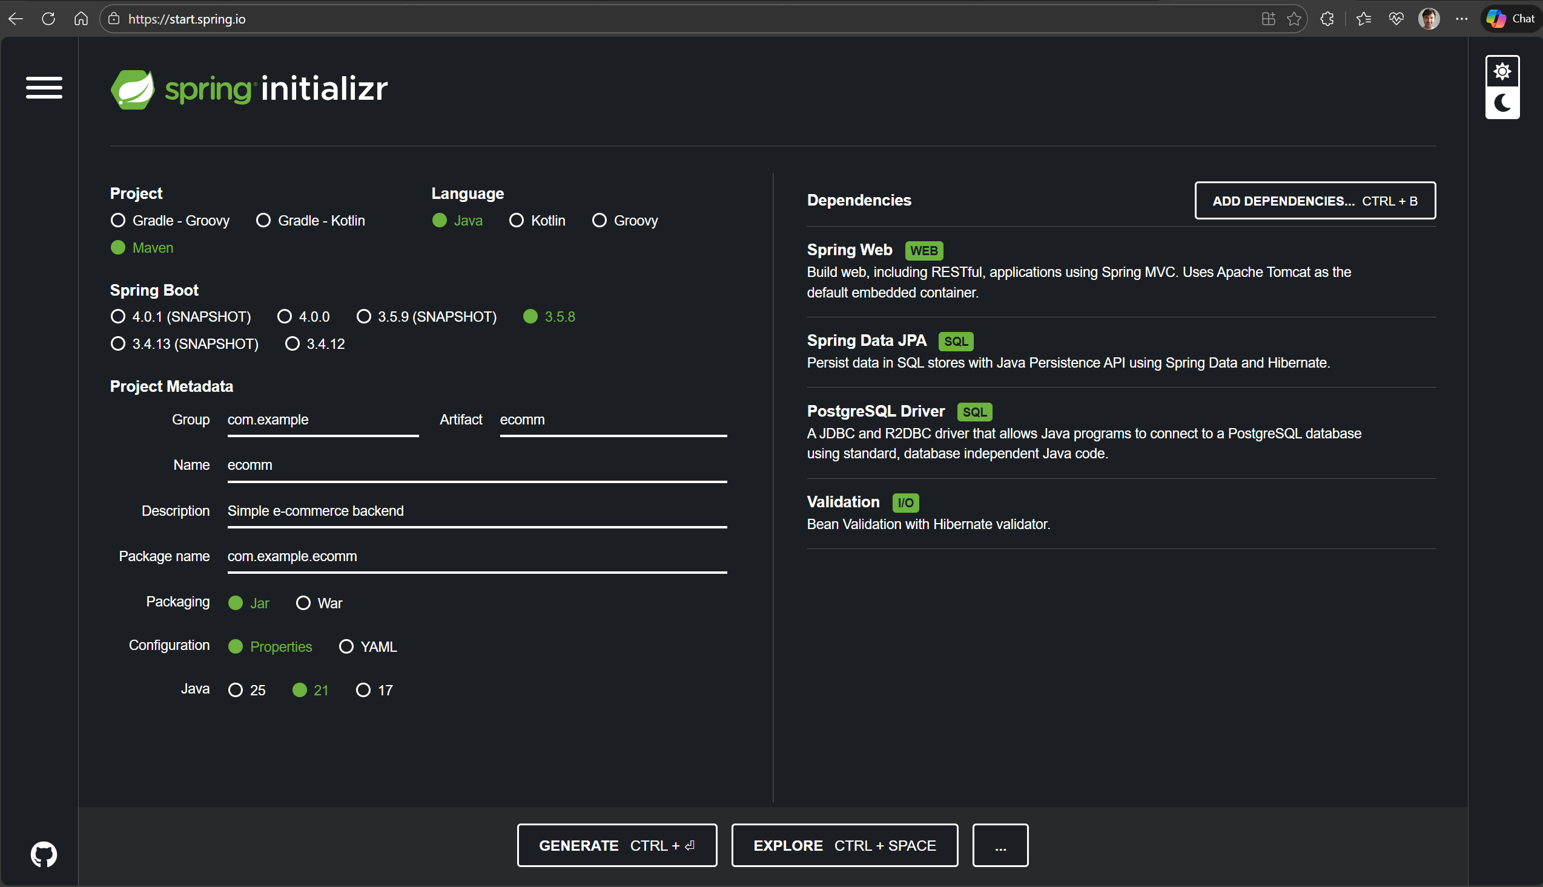
Spring Boot Starter

Slide 3
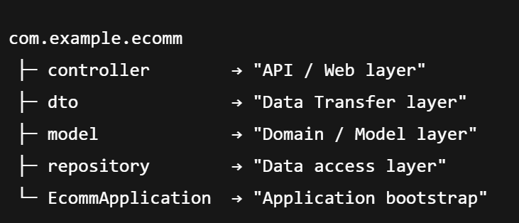
Layered backend architecture
Why layers?
Separate responsibilities
Make code easier to test and maintain
Allow you to change one piece (e.g. database) without rewriting everything

Slide 4
Application bootstrap – “Where does it all start?”
Class: EcommApplication in com.example.ecomm
Role
Main entry point of the Spring Boot application.
Contains the main method and @SpringBootApplication.
What @SpringBootApplication does:
Enables component scanning:
  Finds @RestController, @Repository, @Entity, etc. in com.example.ecomm package.
Turns on auto-configuration:
  Reads application.properties and configures DataSource, JPA, Tomcat server, etc.
Simplifies bootstrapping:
  You just run main, and the whole web server + DB connection is ready.

Slide 5
Model layer (1) – “What is our data?”
Package: com.example.ecomm.modelExample class: Product
Role
Represents the core business objects of the system.
In a JPA application, these are usually entities mapped to database tables.
Typical contents (in Product)
Fields: id, name, description, price, imageUrl, featured, details
JPA annotations:
  @Entity – marks the class as a JPA entity
  @Table(name = "products") – maps to the products table
  @Id, @GeneratedValue – primary key configuration
  @Column – column details (length, TEXT, nullable, etc.)

Slide 6
Model layer (2) – “What is our data?”
Important techniques
JPA mappings
  One-to-Many, Many-to-One (@OneToMany, @ManyToOne, etc.)
  Validation annotations (optional but common):
    @NotNull, @Size, @Positive from jakarta.validation
Encapsulation
  Use getters/setters or constructors to keep the model consistent
Business rules
  Some simple invariants can be enforced here
  Example: setPrice shouldn’t allow negative numbers

Slide 7
Repository layer (1) – “How do we talk to the database?”
Package: com.example.ecomm.repository
Example class: ProductRepository (extends JpaRepository<Product, Long>)
Role
Provides an abstraction over the database.
The rest of the application does not write SQL directly.
Uses Spring Data JPA to generate queries.
Typical features in ProductRepository
Inherit CRUD methods from JpaRepository:
  findAll(), findById, save, deleteById, …
Custom query methods using method names:
  List<Product> findByFeaturedTrueOrderByIdDesc();
Optional @Query methods for more complex SQL / JPQL.

Slide 8
Repository layer (2) – “How do we talk to the database?”
Important techniques
Method name queries
  Spring parses names like findByFeaturedTrueOrderByIdDesc → generates SQL
Pagination & sorting
  Page<Product> findAll(Pageable pageable);
  Useful for listing products page by page
Separation of concerns
  Controllers and services never need to know how data is stored
  If you change from PostgreSQL to MySQL, repository interface stays the same

Slide 9
DTO layer (1) – “What do we send over the network?”
Package: com.example.ecomm.dto
Example class: ProductDTO
Role
DTO = Data Transfer Object
Represents the data shape that the API exposes to clients (React frontend).
Helps to decouple:
  internal entity structure (Product)
  external JSON contract (ProductDTO)
Why not return Product directly?
Security: maybe you don’t want to expose internal fields (e.g. internal IDs, audit columns).
Stability: DTO can remain stable even if the entity changes (e.g. new fields).
Transformation: you can format data differently for the API (e.g. combine fields, hide fields).

Slide 10
DTO layer (2) – “What do we send over the network?”
Typical contents
Fields that are safe and useful for the client:
  id, name, description, price, imageUrl, details
Constructors + getters/setters.
In the controller, you map Product → ProductDTO with .map(...) on a stream.
Important techniques
Manual mapping (what we do now)
  Simple and explicit
Mapping libraries (advanced)
  ModelMapper, MapStruct, etc. for larger projects
Versioning
  DTOs make it easier to introduce ProductV2DTO later without breaking old clients

Slide 11
Controller layer – “How do clients talk to us?”
Package: com.example.ecomm.controller
Example class: ProductController
Role
Implements the REST API endpoints.
Receives HTTP requests, calls business/data logic, returns HTTP responses (JSON).
Uses data from repositories, and exposes DTOs.
Typical contents
Class-level annotations:
  @RestController – marks the class as a REST controller
  @RequestMapping("/api/products") – prefix for all endpoints
Methods:
  @GetMapping – e.g. GET /api/products
  @GetMapping("/{id}") – GET /api/products/5
  @PostMapping, @PutMapping, @DeleteMapping (for create/update/delete)

Slide 12
Controller layer (2) – “How do clients talk to us?”
Example responsibilities:
Call repository methods
Map Product → ProductDTO
Handle HTTP status codes (200 OK, 404 Not Found, etc.)
Optionally validate input (@Valid on request bodies)
Important techniques
Path variables & query params
  @PathVariable Long id
  @RequestParam(required = false) Boolean featured
Validation
  @Valid + validation annotations on DTOs
Exception handling
  @ControllerAdvice + @ExceptionHandler to centralize error responses
CORS config (for React frontends)
  e.g. @CrossOrigin(origins = "http://localhost:3000") or global config

Slide 13
Resources & configuration
Folder: src/main/resources
application.properties
  Database configuration
  JPA/Hibernate settings
  Server port
data.sql / schema.sql or createTable.sql
  Initial schema/data scripts
static/images
  Static assets (product images), served by Spring as /images/...
Role in architecture:
Keeps configuration and static assets outside Java code.
Supports different profiles:
  e.g. application-dev.properties, application-prod.properties

Slide 14
Typical request flow in this project (1)
Example: React calls GET /api/products/5
Client (React)
Sends HTTP GET request to http://localhost:8080/api/products/5.
Controller (ProductController)
  Endpoint: @GetMapping("/{id}")
  Uses ProductRepository to load a Product entity.
  Maps entity → ProductDTO.
  Returns ProductDTO as JSON.
Repository (ProductRepository)
  Calls the database via JPA/Hibernate.
  Executes the appropriate SQL.

Slide 15
Typical request flow in this project (2)
Model (Product)
  Represents the row from products table.
  JPA maps columns to fields.
Response to client
  JSON with fields from ProductDTO:
    id, name, description, price, imageUrl, details
For images:
JSON contains imageUrl: "/images/coffee.jpg".
React builds full URL and requests http://localhost:8080/images/coffee.jpg.
Spring Boot serves the static file from resources/static/images.

Slide 16
Configurations in appication.properties
# === PostgreSQL Config ===
spring.datasource.url=jdbc:postgresql://localhost:5432/ecommdb
spring.datasource.username=postgres
spring.datasource.password=123456
spring.datasource.driver-class-name=org.postgresql.Driver
# JPA / Hibernate
spring.jpa.hibernate.ddl-auto=update
spring.jpa.show-sql=true
spring.jpa.properties.hibernate.format_sql=true
spring.jpa.properties.hibernate.dialect=org.hibernate.dialect.PostgreSQLDialect
# Server port
server.port=8080

Slide 17
DataSource / Database settings
spring.datasource.url
What it does: Defines how to connect to the database.
spring.datasource.url=jdbc:postgresql://localhost:5432/ecommdb
Breakdown:
jdbc:postgresql → use the PostgreSQL JDBC driver
localhost → the database is running on the same machine
5432 → default PostgreSQL port
ecommdb → database name
So, this means:
“Connect to the ecommdb database on localhost:5432 using the PostgreSQL driver.”

Slide 18
spring.datasource.username & spring.datasource.password
What they do:
These are the database login credentials used by Spring Boot.
username → database user
password → that user’s password
In a real production system do not hard-code the password here, but use environment variables. Write their real values to the environment of the server.
spring.datasource.username=${DB_USER}
spring.datasource.password=${DB_PASS}

Slide 19
spring.datasource.driver-class-name
What it does:
Tells Spring which JDBC driver class to use for the connection.
Since we added the PostgreSQL dependency in pom.xml, this driver is available, and Spring uses it to talk to PostgreSQL.
spring.datasource.driver-class-name=org.postgresql.Driver

Slide 20
JPA / Hibernate settings
spring.jpa.hibernate.ddl-auto=update
What it does:
Controls how Hibernate handles the database schema (tables, columns) at startup.
Common values:
create – drop and recreate all tables on every startup (data is lost)
create-drop – create tables at startup, drop them when the app stops
update – try to update the existing schema to match your entity classes
validate – only check if the schema matches the entities; do not change anything
Update: “At startup, compare the entity classes to the database tables and automatically add/modify columns when possible.”
This is very convenient for development and student projects.
Validate: In production (for real-life projects): Generally, a validate + migration tool (Flyway/Liquibase) is preferred.

Slide 21
Short Summary of Settings
DataSource properties
spring.datasource.url → where is the database?
spring.datasource.username/password → how to log in
spring.datasource.driver-class-name → which JDBC driver to use
JPA/Hibernate properties
spring.jpa.hibernate.ddl-auto → how to manage the schema (update in dev)
spring.jpa.show-sql → log generated SQL
spring.jpa.properties.hibernate.format_sql → pretty-print SQL
spring.jpa.properties.hibernate.dialect → SQL dialect for the chosen DB
Server property
server.port → which HTTP port the backend uses

Slide 22

Thank you!

